Slide 1
Text Processing, Addressing and Synchronization
Chapter 2.9, 2.10, 2.11

Slide 2
Outline
Character data and operators
Addressing methods
Processes synchronization instructions

Slide 3
Character Data
Byte-encoded character sets
ASCII: 128 characters
95 graphic, 33 control
Latin-1: 256 characters
ASCII, +96 more graphic characters
Unicode: 32-bit character set
Used in Java, C++ wide characters, …
Most of the world’s alphabets, plus symbols
UTF-8, UTF-16: variable-length encodings

Slide 4
String Copy Example
C code (naïve):
Null-terminated string
void strcpy (char x[], char y[]) //copy y[] to x[] { int i; i = 0; while ((x[i]=y[i])!='\0') i += 1; }
Addresses of x, y in $a0, $a1
i in $s0

Slide 5
String Copy Example
MIPS code:
strcpy: addi $sp, $sp, -4 # adjust stack for 1 item sw $s0, 0($sp) # save $s0 add $s0, $zero, $zero # i = 0 L1: add $t1, $s0, $a1 # addr of y[i] in $t1, addr of y[] in $a1 lbu $t2, 0($t1) # $t2 = y[i], use lbu because y[i] is a byte add $t3, $s0, $a0 # addr of x[i] in $t3, addr of x[] in $a0 sb $t2, 0($t3) # x[i] = y[i]; sb is store byte beq $t2, $zero, L2 # exit loop if y[i] == 0 addi $s0, $s0, 1 # i = i + 1 j L1 # next iteration of loop L2: lw $s0, 0($sp) # restore saved $s0 addi $sp, $sp, 4 # pop 1 item from stack jr $ra # and return
How is Java different? For one, Java uses 16 bit characters (Unicode)

Slide 6
Byte/Halfword Operations
Could use bitwise operations
MIPS byte/halfword load/store
String processing is a common case
lb rt, offset(rs) lh rt, offset(rs)
lbu rt, offset(rs) lhu rt, offset(rs)
Zero extend to 32 bits in rt
sb rt, offset(rs) sh rt, offset(rs)
Store just rightmost byte/halfword

Slide 7
32-bit Constants
Most constants are small
16-bit immediate is sufficient
For the occasional 32-bit constant
lui rt, constant
Copies 16-bit constant to left 16 bits of rt
Clears right 16 bits of rt to 0
How to load -> into $s0?
0000 0000 0111 1101 0000 1001 0000 0000
lhi $s0, 61
0000 0000 0111 1101 0000 0000 0000 0000
ori $s0, $s0, 2304
0000 0000 0111 1101 0000 1001 0000 0000
Notes:
lhi $s0 constant // load upper half of $s0
ori $s0, $s0 constant

Slide 8
Branch Addressing
Branch instructions specify
Opcode, two registers, target address
Most branch targets are near branch
Forward or backward
op
rs
rt
constant or address
6 bits
5 bits
5 bits
16 bits
PC-relative addressing
Target address = PC + offset × 4 /* PC is program counter
PC already incremented by 4 by this time

Slide 9
Jump Addressing
Jump (j and jal) targets could be anywhere in text segment
Encode full address in instruction
op
address
6 bits
26 bits
(Pseudo)Direct jump addressing
Target address = PC_{31…28} : (address × 4)

Slide 10
Target Addressing Example
Loop code from earlier example
Assume Loop at location 80000
Loop: sll $t1, $s3, 2 | 80000 | 0 | 0 | 19 | 9 | 4 | 0
add $t1, $t1, $s6 | 80004 | 0 | 9 | 22 | 9 | 0 | 32
lw $t0, 0($t1) | 80008 | 35 | 9 | 8 | 0
bne $t0, $s5, Exit | 80012 | 5 | 8 | 21 | 2
addi $s3, $s3, 1 | 80016 | 8 | 19 | 19 | 1
j Loop | 80020 | 2 | 20000
Exit: … | 80024
2 words after
20000 x 4
Notes:
The program is: while (save[i] == k) i += 1; i is in $s3, k in $s5 and save is in $s6

Slide 11
Branching Far Away
If branch target is too far to encode with 16-bit offset, assembler rewrites the code
Example
beq $s0,$s1, L1 #L1 has only 16 bits here
↓
bne $s0,$s1, L2 j L1 #L1 now has 26 bits L2: …

Slide 12
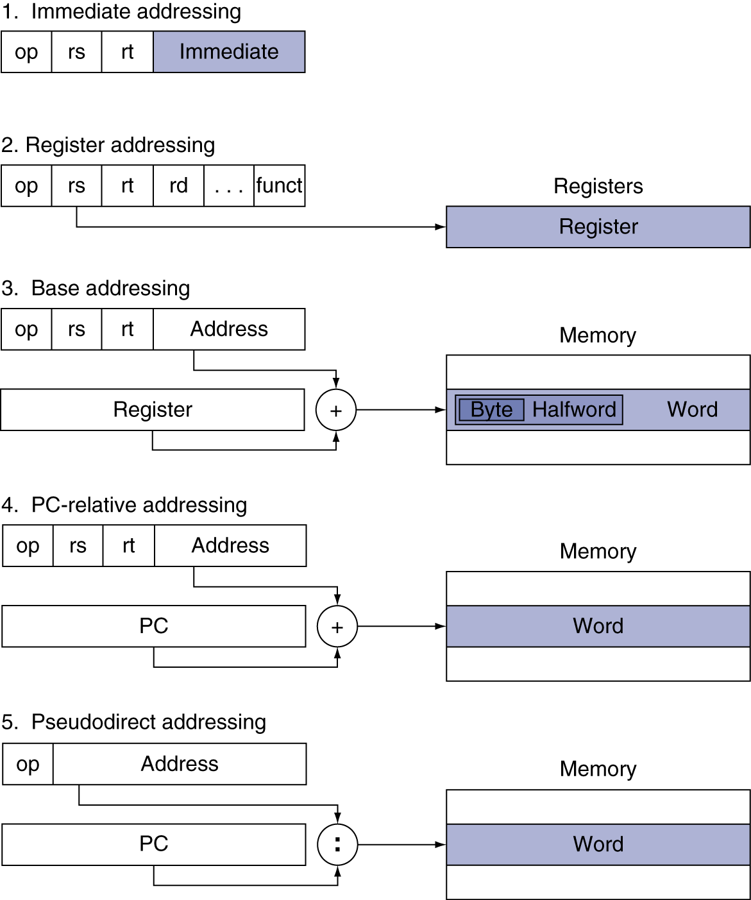
Addressing Mode Summary

Slide 13
Synchronization
Two processors sharing an area of memory
P1 writes, then P2 reads
Data race if P1 and P2 don’t synchronize
Result depends of order of accesses
Hardware support required
Atomic read/write memory operation
No other access to the location allowed between the read and write
Could be a single instruction
E.g., atomic swap of register ↔ memory
Or an atomic pair of instructions
Notes:
Lock(s); {while (lock == 1) //spin; lock = 1;}
Do something();
Unlock(s) {lock = 0;}

Slide 14
Synchronization in MIPS
Load linked: ll rt, offset(rs)
Store conditional: sc rt, offset(rs)
Succeeds if location not changed since the ll
Returns 1 in rt
Fails if location is changed
Returns 0 in rt
Example: atomic swap (to test/set lock variable)
try: add $t0,$zero,$s4 ;copy exchange value
ll $t1,0($s1) ;load linked
sc $t0,0($s1) ;store conditional
beq $t0,$zero,try ;branch store fails
add $s4,$zero,$t1 ;put load value in $s4
Notes:
Lock exchange: If (lock == 0) {lock = 1; enter} else wait();
Two requirements: (1) The exchange is atomic; (2) the operations are ordered by hardware.

